Slide 1

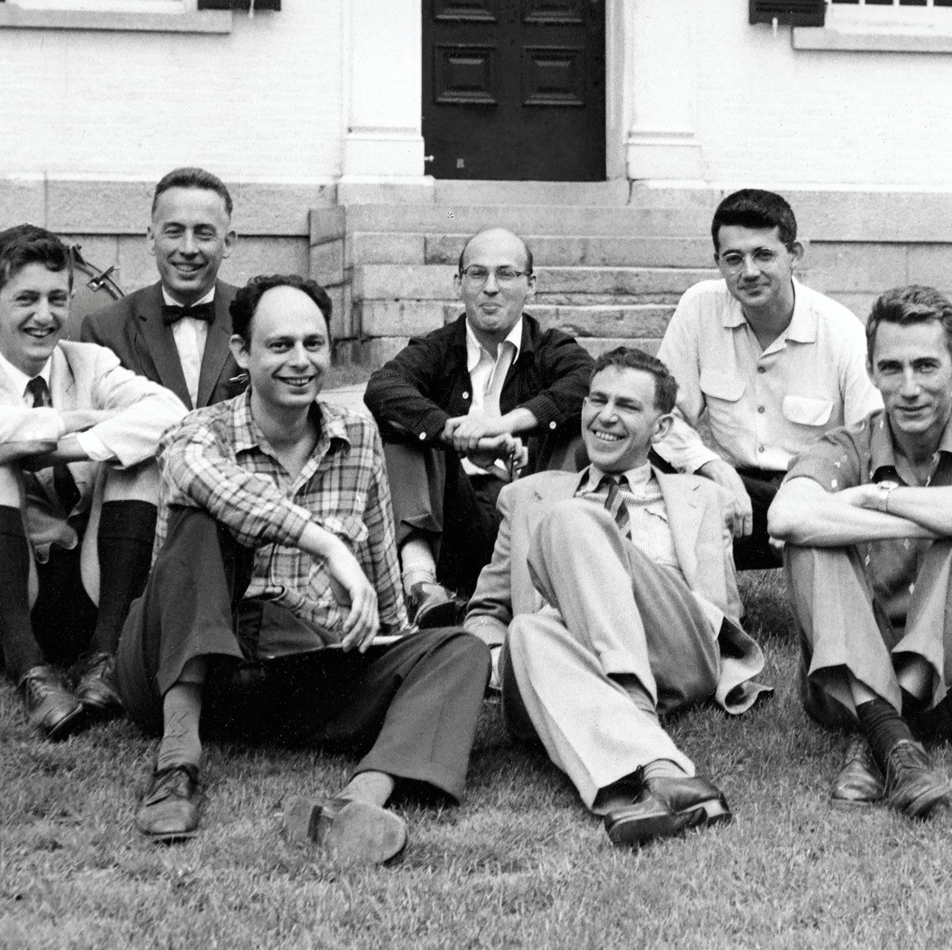
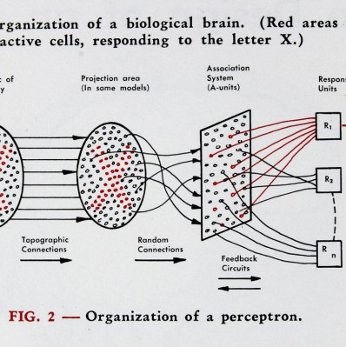
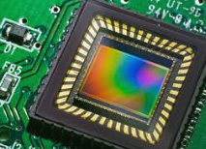
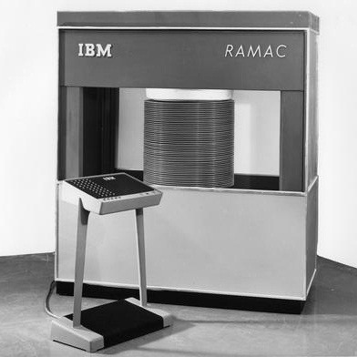
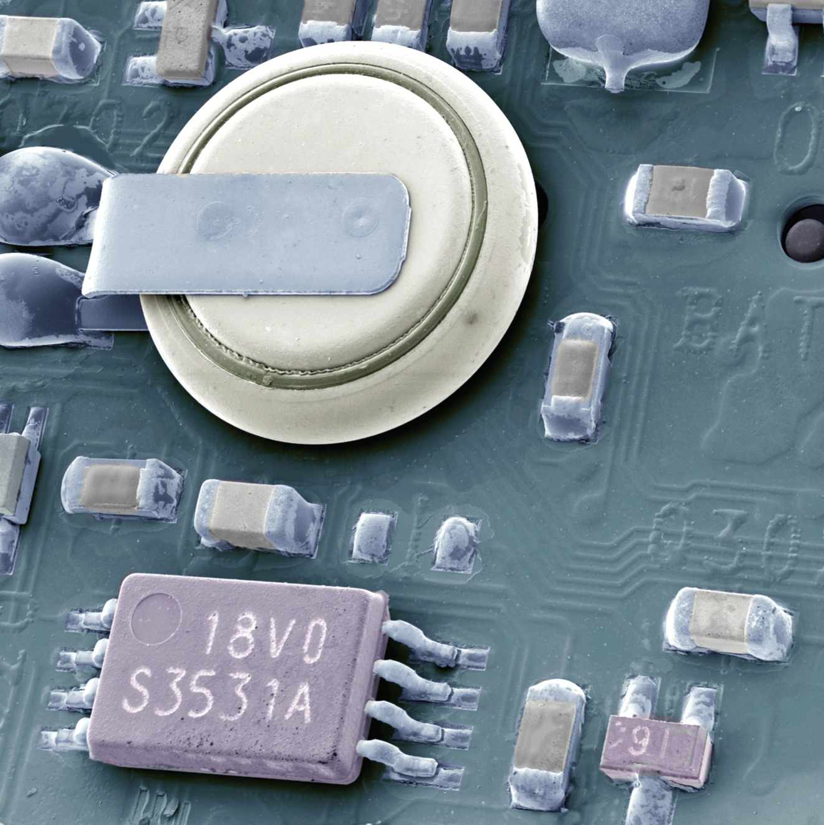
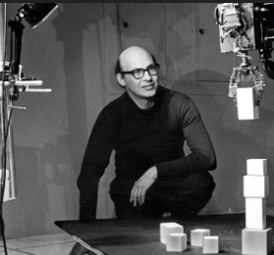
Computer vision 1950s – 1960s
Click here for sound →
Rathnam/Igwilo/Champion/Zadran
Professor McManus
ITAI 1378
7 June 2024
AI term created
1956
Charge coupled device
During the Dartmouth Summer Research Project organized by Marvin Minksy, John McCarthy, Claude Shannon, and Nathaniel Rochester, also known as the “found fathers” of AI, the term “Artificial Intelligence” was coined.
In the Fall of 1969, the Charge Coupled Device (CCD) was invented by Willard S. Boyle and George E. Smith. This device converted photon into electrical impulses to capture high-quality images.
Perceptron
Frank Rosenblatt created the Perceptron, a neural network for pattern recognition that was run on IBM’s room sized 704 computer. Rosenblatt stated that the Perceptron would be the first machine “capable of having an original idea.”
1957
1969
Model 350
1954
Complementary mos circuit configuration
1963
Summer vision
Reynold Johnson and his team developed the first commercial hard disk drive. There were 50 individual disks 1-inch thick and 24-inches in diameter that totaled to 3.75 megabytes of storage.
Frank Wanlass invented the Complementary MOS Circuit (CMOS). The CMOS is a battery powered chip that stores the system settings, configurations, time/date, and password settings.
In the summer of 1966, Marvin Minsky and Seymour Papert developed figure-ground analysis and pattern recognition using research from decades previous in a small lab at MIT. This served as the starting point for research to come and the beginnings of Computer Vision.
1966

